Slide 1


IBAAS 2025
TECHNICAL LECTURE SERIES
ADAPT: An AI-Powered Platform for Modernizing Legacy PLCs into a Real-Time Plant-Wide IoT System with Enhanced Downstream Process Efficiency and Control
Ashutosh Kumar, 7903620014, ashutoshkumar@calicheglobal.com

Slide 2
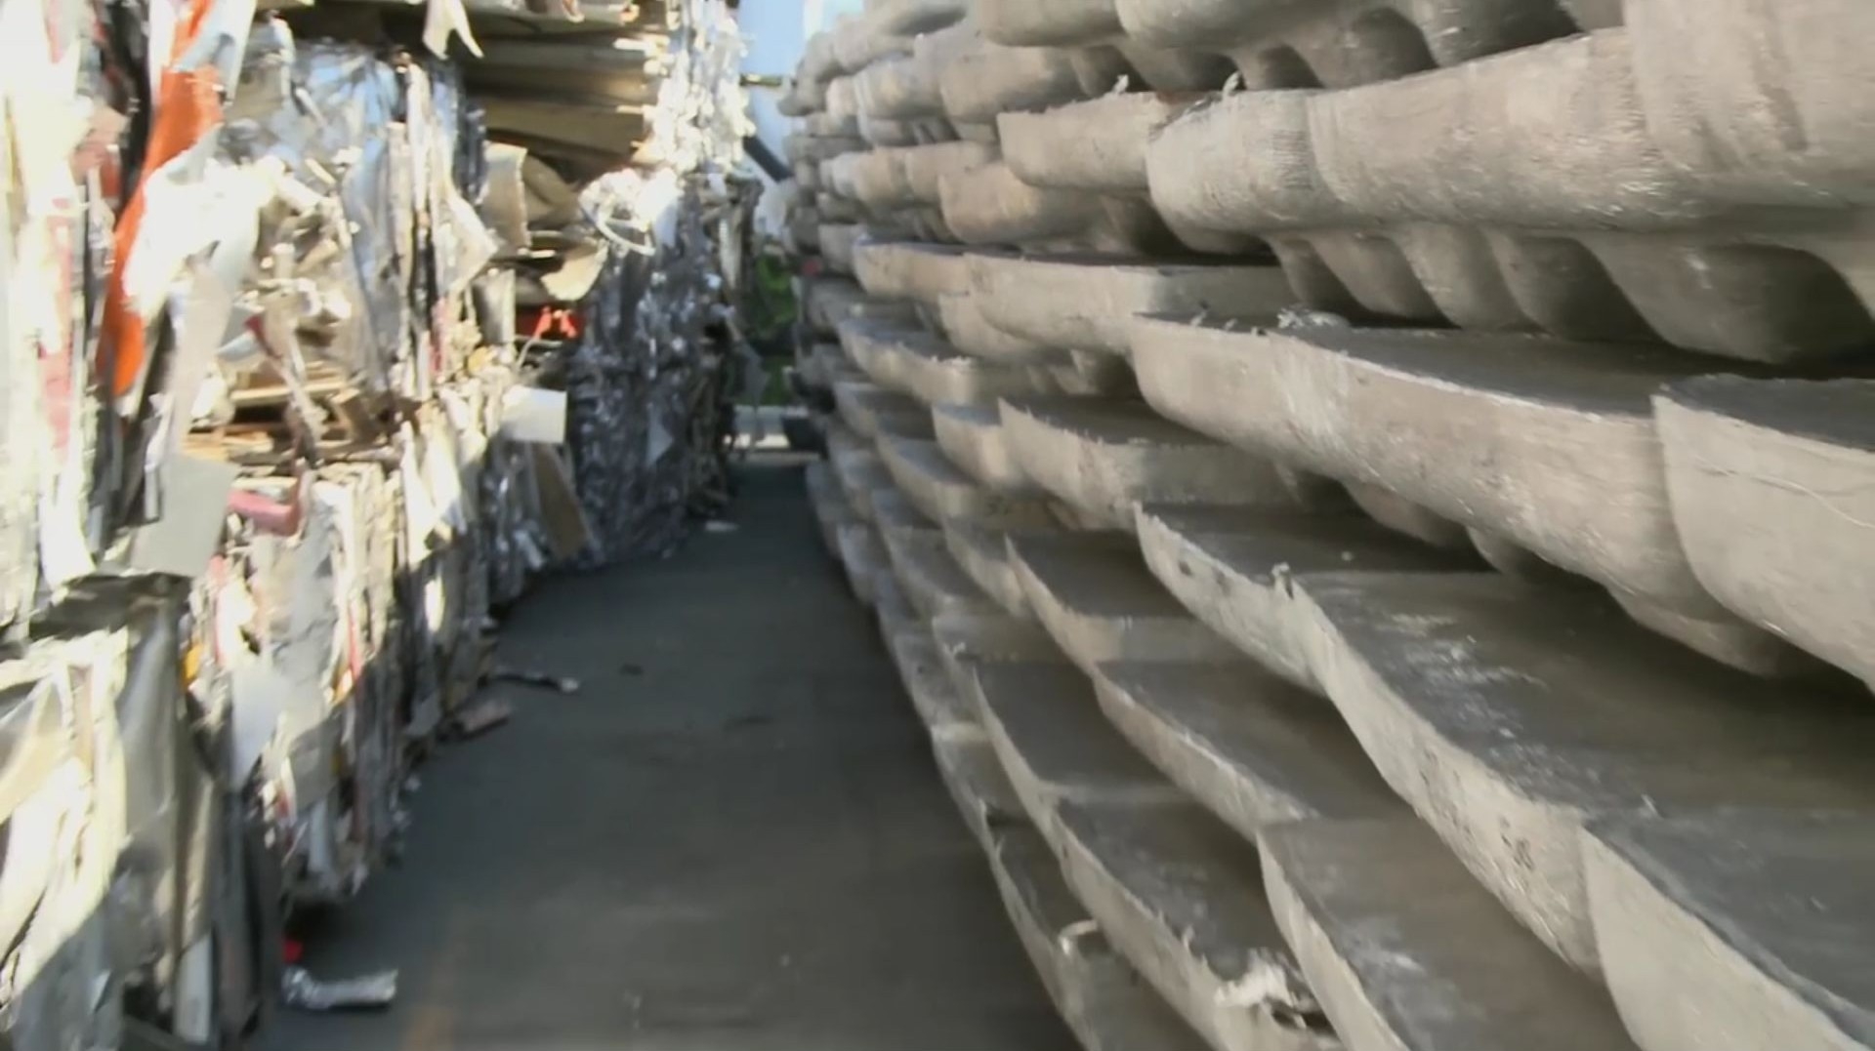
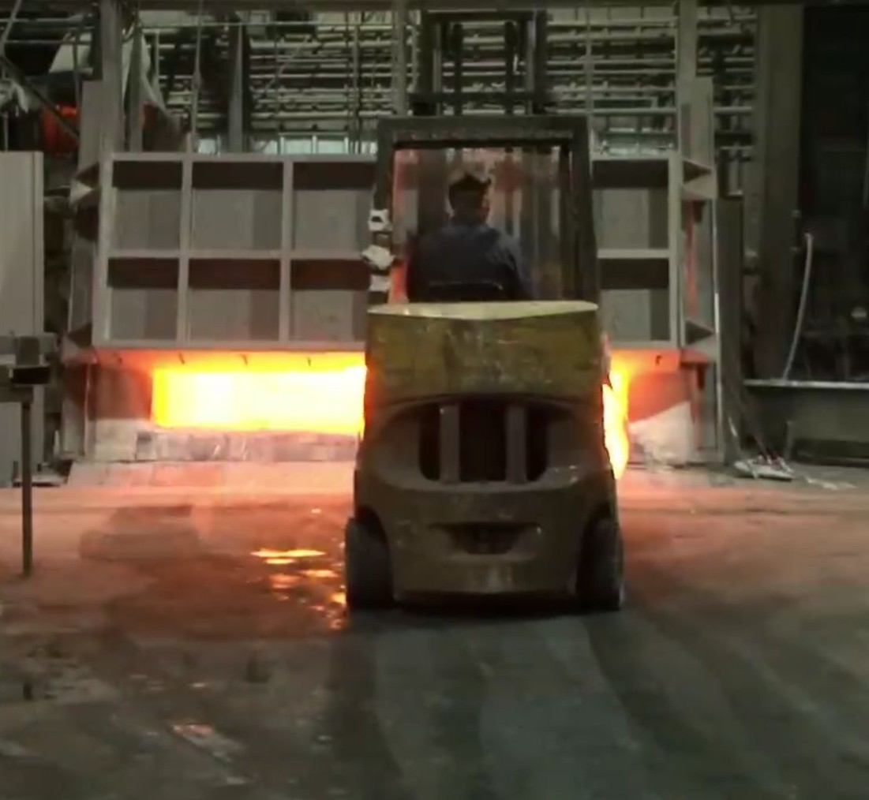
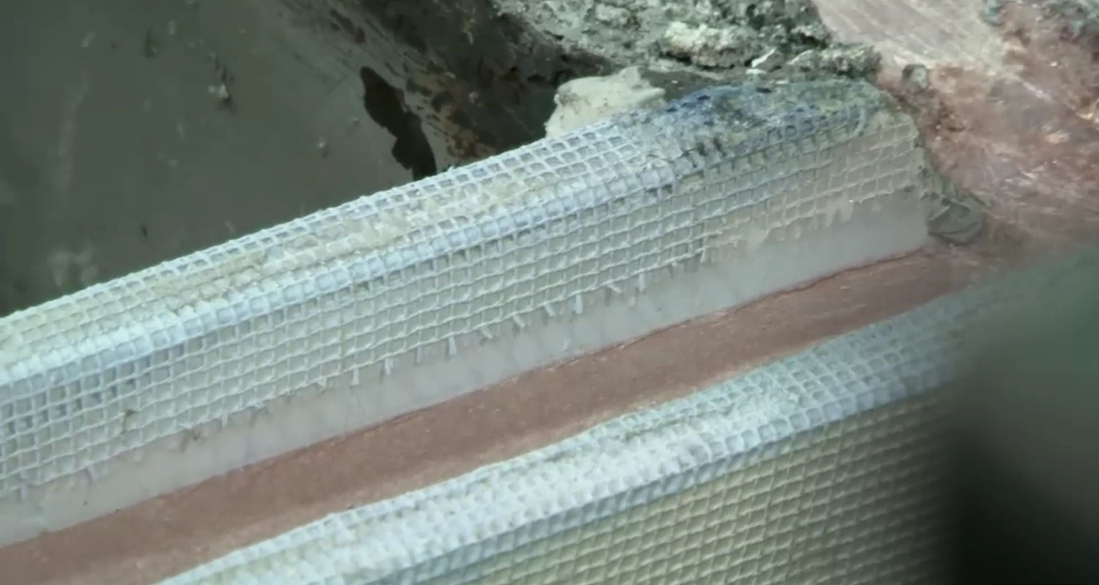
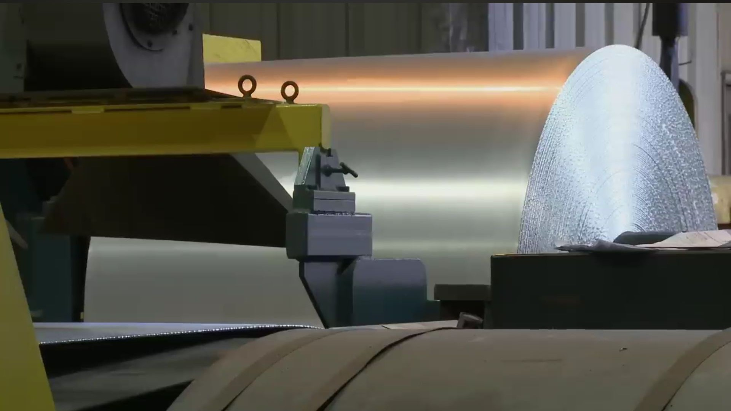
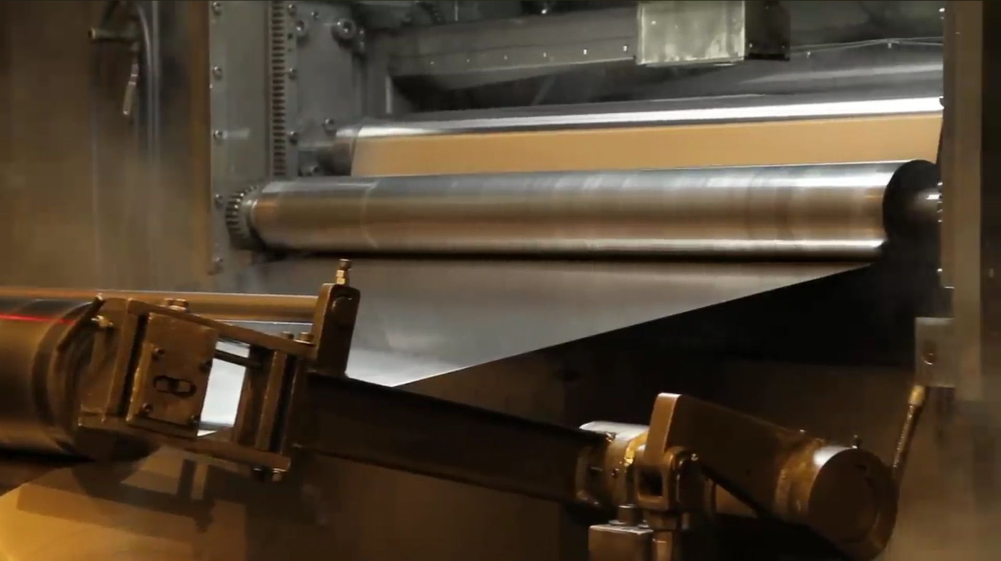
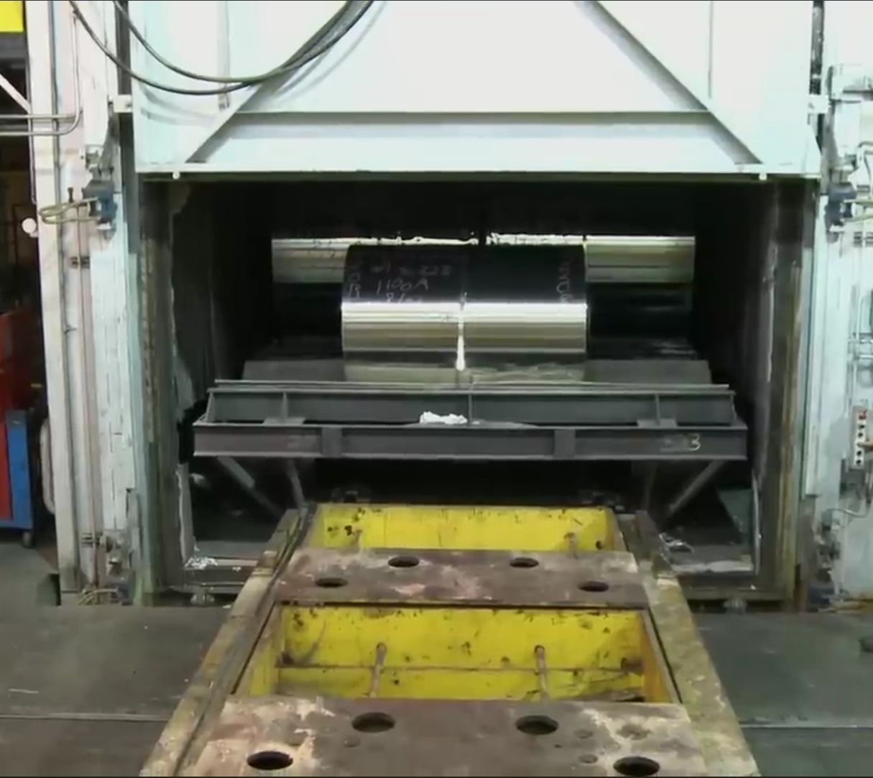
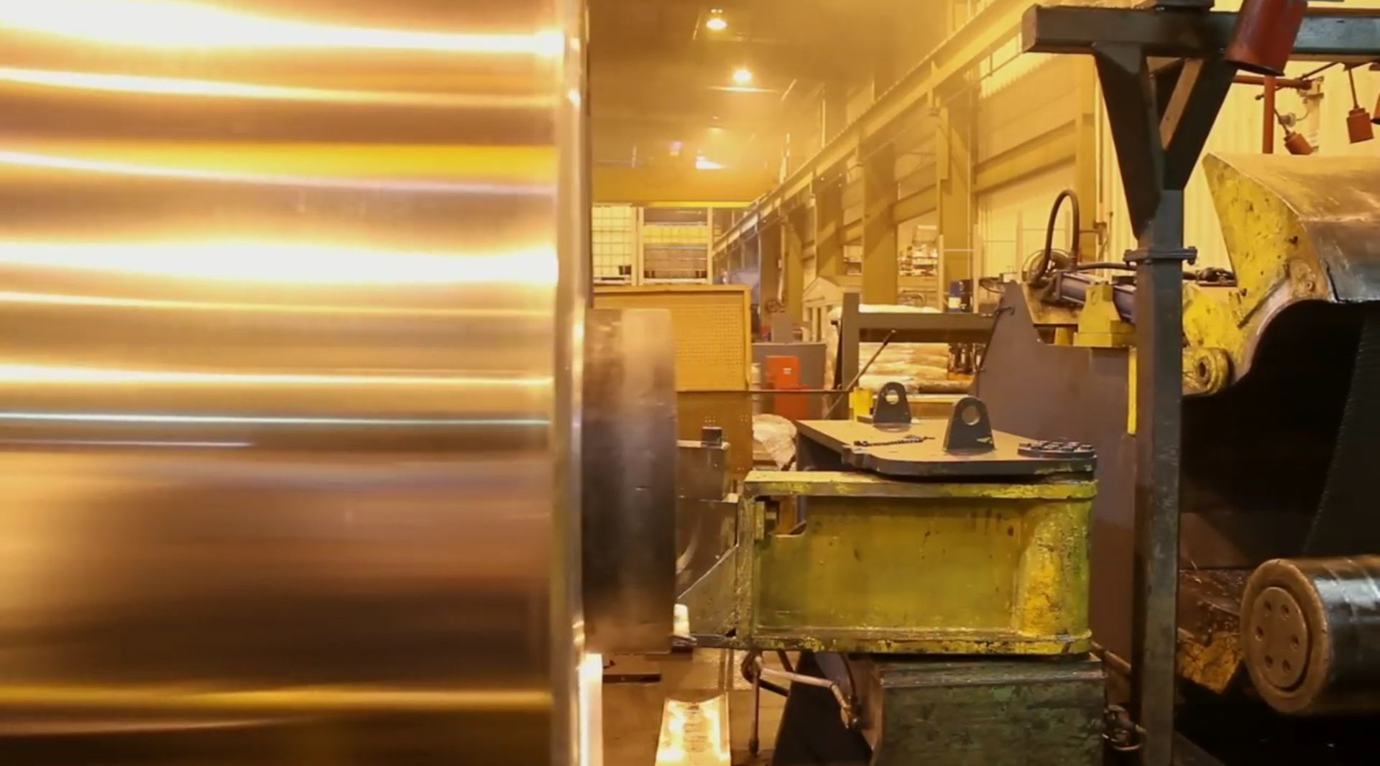
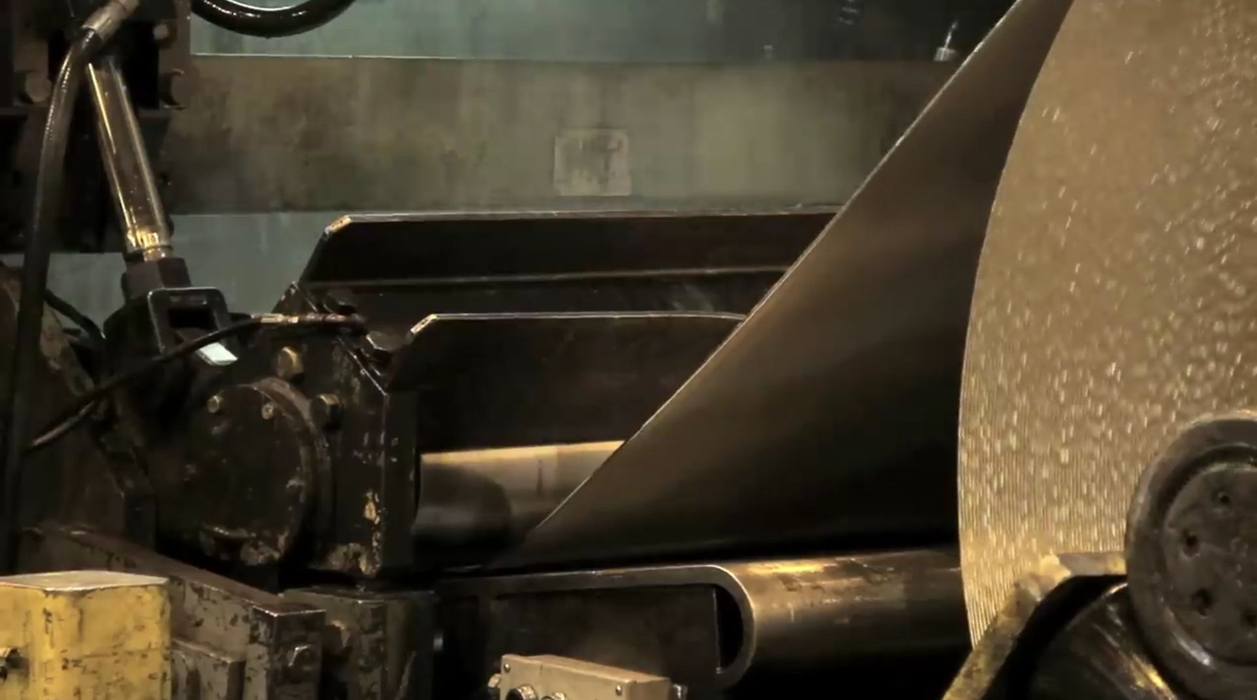

Aluminium Cold Pressed Rolling: Reality
Existing flow (the way it appears)
Ingots & scraps
Melting furnace
Casting - caster
Material flow from Caster, Annealing furnace, Crane, Mills, Holding furnace, Light Slitters, to the final product, tensile-elongation-Olsen test
PLC for Machines, Human machine interface for operators, log books/registers & whatsapp
First roll - coming out of caster
groups
Acceptable gauge of final product
Annealing Furnace
Inter mill transfer with cranes
Thickness reduction on mills

Slide 3
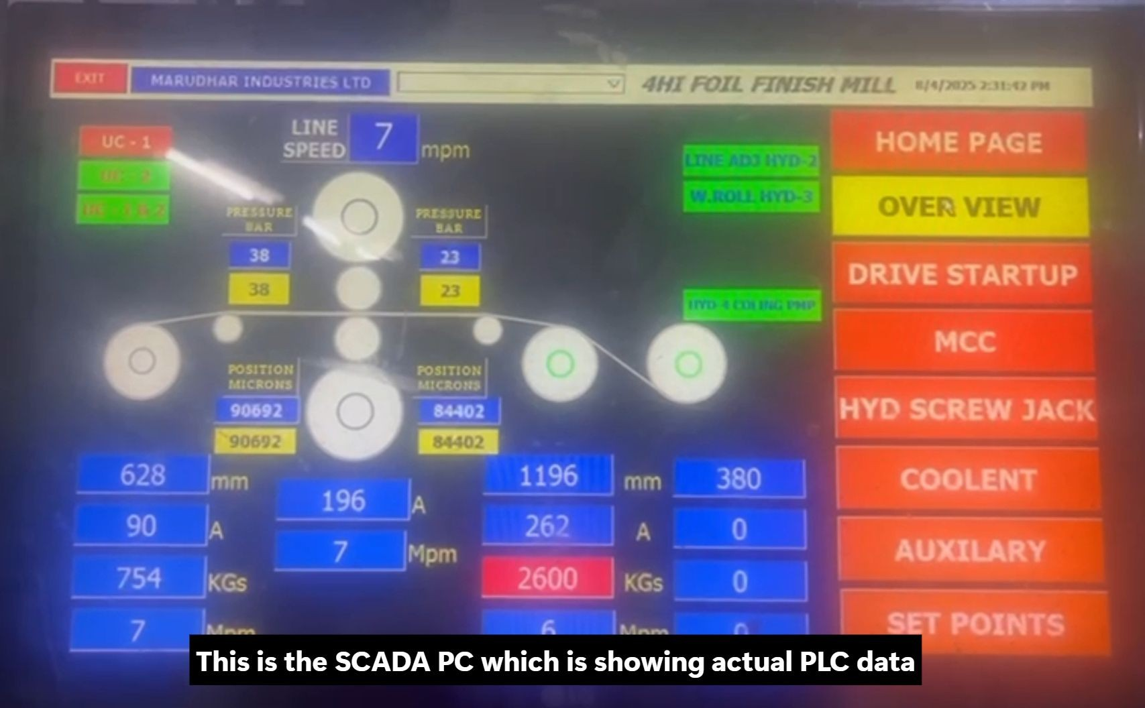
Aluminium Cold Pressed Rolling: Facts
Input & Identification Data: Selection or entry of spool numbers, coil numbers, alloy (auto-fetched), internal diameter (auto-fetched), gauges, widths, radii, weights, joints count, shift, operator name, and timestamp. Output & Production Details: Output spool and coil numbers, output width, output radius (manual + HMI-fetched), actual output weight, work roll number, and verification by operator/supervisor.
Mill Operation Parameters: Machine line speed, main mill motor speed and current, gauge, jack positions and pressures, along with spare mill real-time parameters.
Coiler & Uncoiler Parameters: Motor speeds, currents, tensions, diameters for coiler and both uncoilers, plus associated spare real-time signals.
System Integration: Combination of manually entered values, auto-fetched database fields, and HMI-driven real-time process data for complete operational traceability.
●
●
●
●

Slide 4
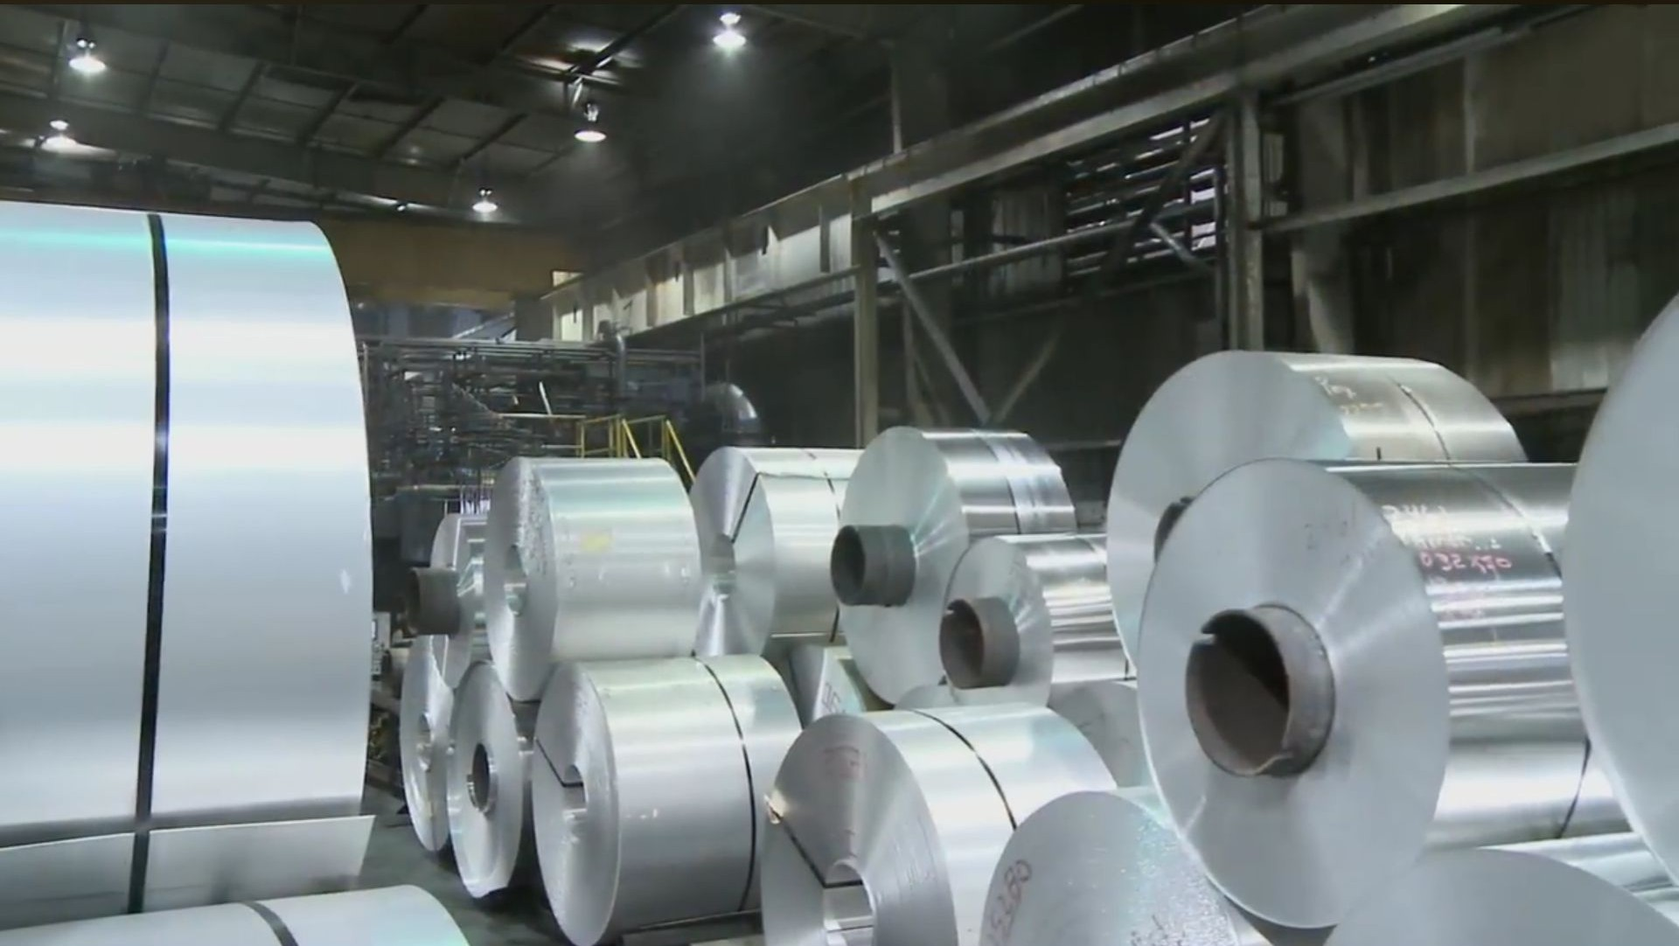
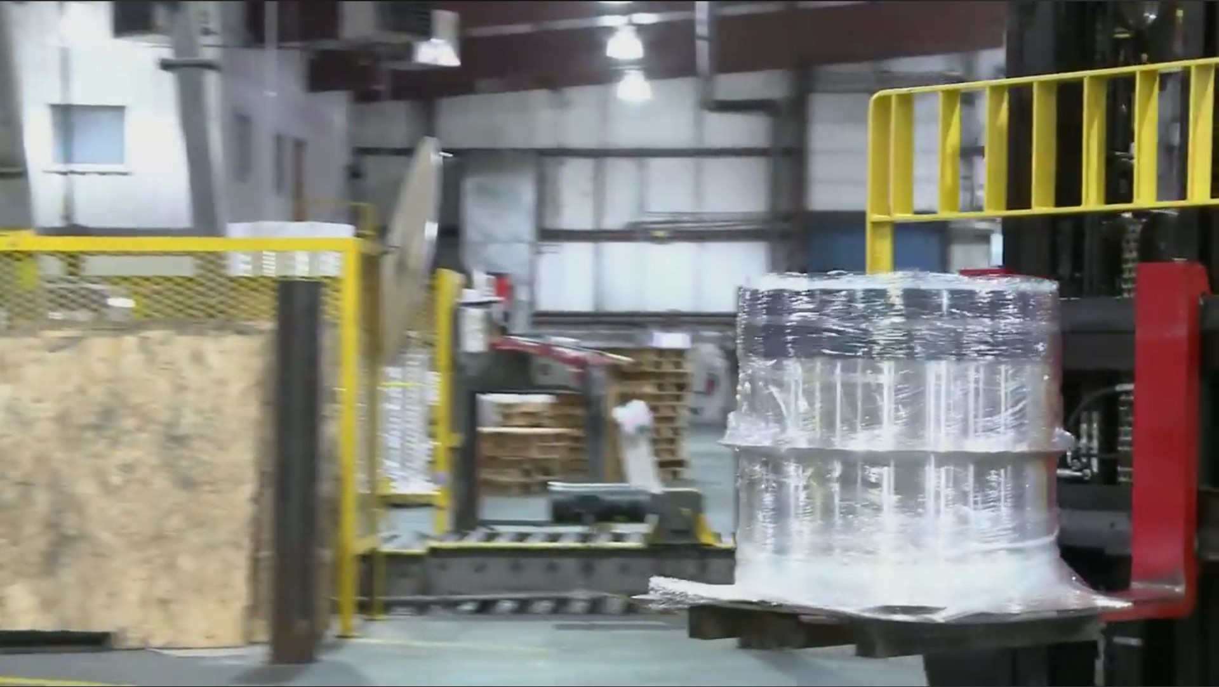
Aluminium Cold Pressed Rolling: Expectations
Existing flow (the way directors and upper management expects)
  Quantity of material waiting different locations, efficient usage of equipment to fulfill orders
  Tenson, pressure, rolling speed etc. to reduce joints

Slide 5
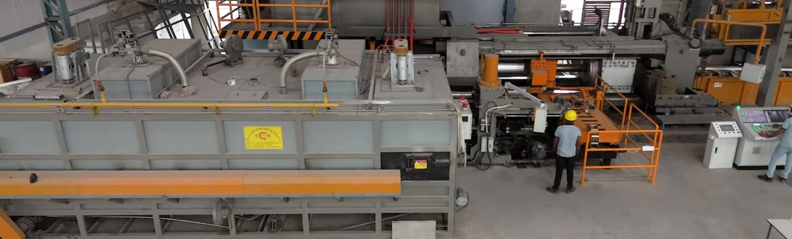
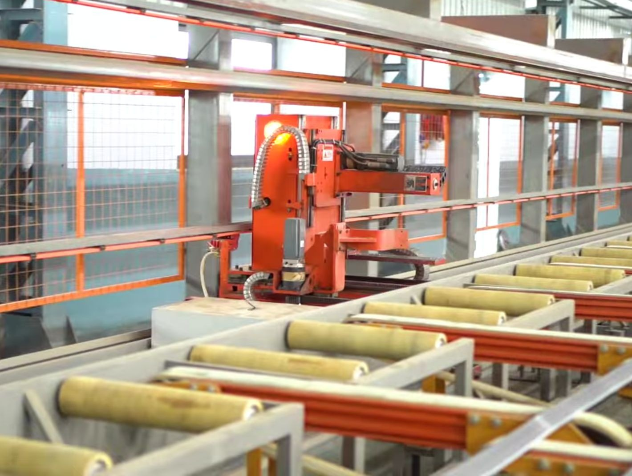
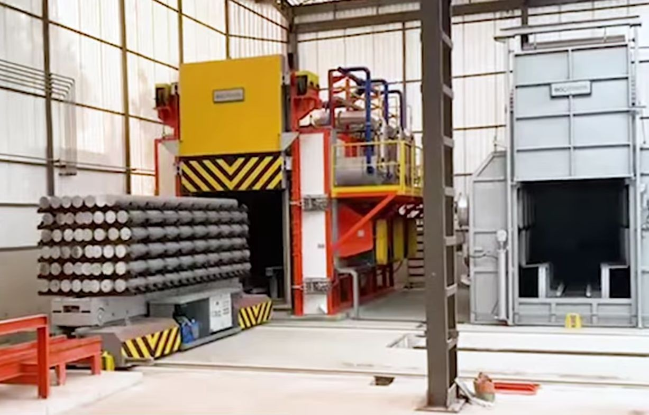
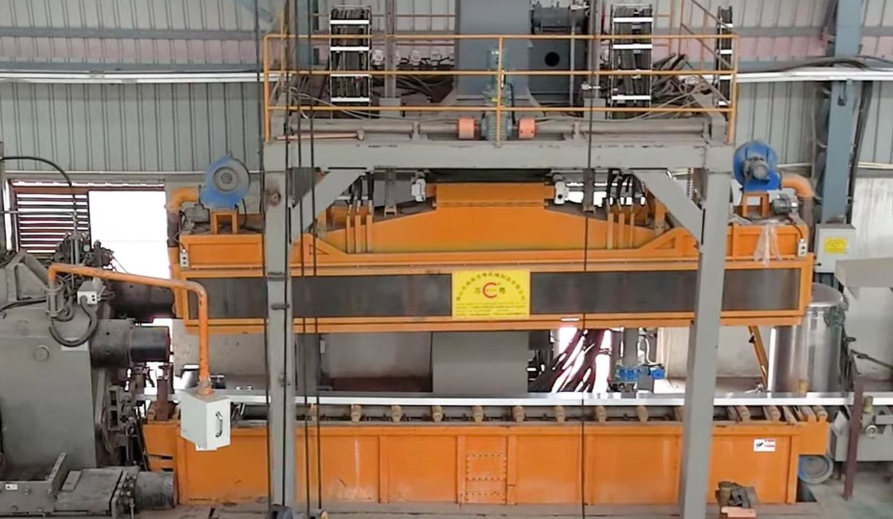
Aluminium Extrusion Mills: Reality
Existing flow (the way it appears)
  Material flow from Extrusion Press,
Homogenising furnace, Automated Material Handling System and Online Quenching System
PLC for Machines, Human machine interface for operators, log books/registers & whatsapp groups
PLC Controlled Extrusion Press
Automated Material Handling
Homogenising Furnace
System
Online Quenching System

Slide 6
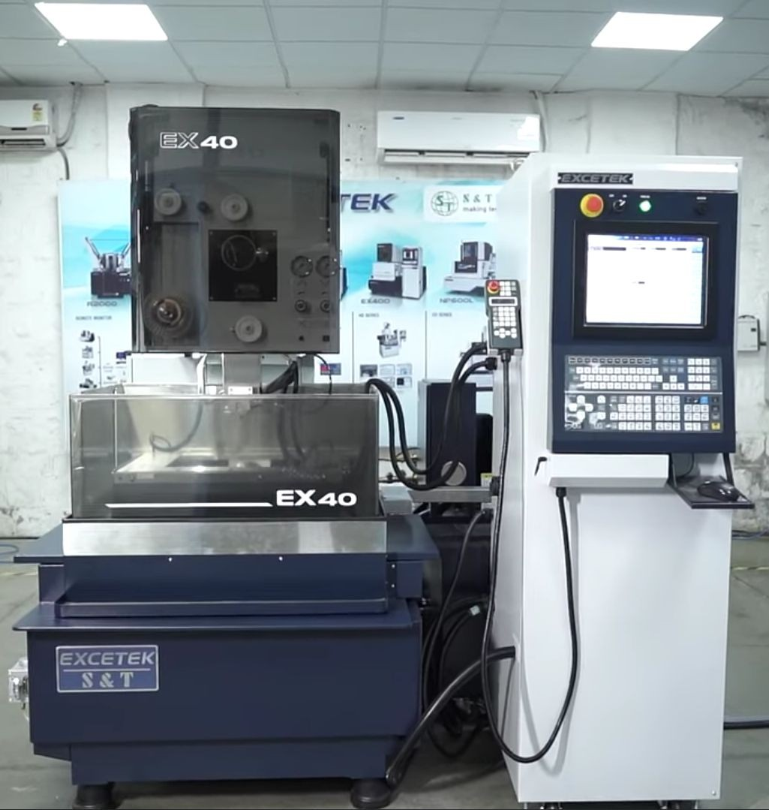
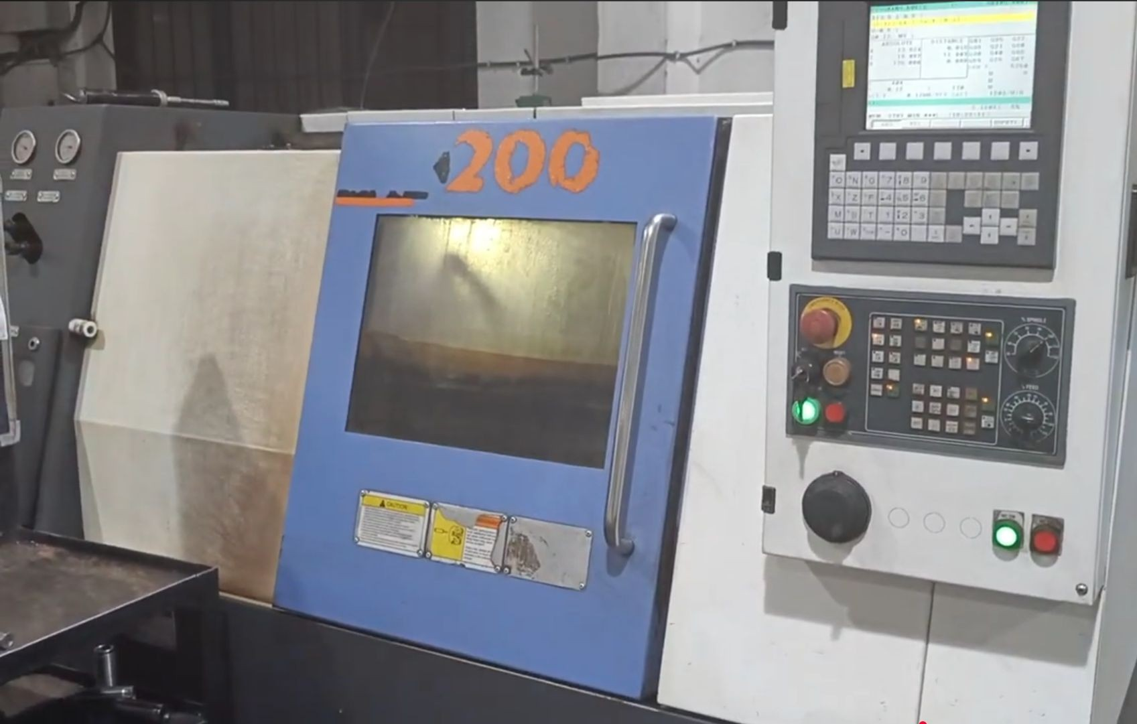
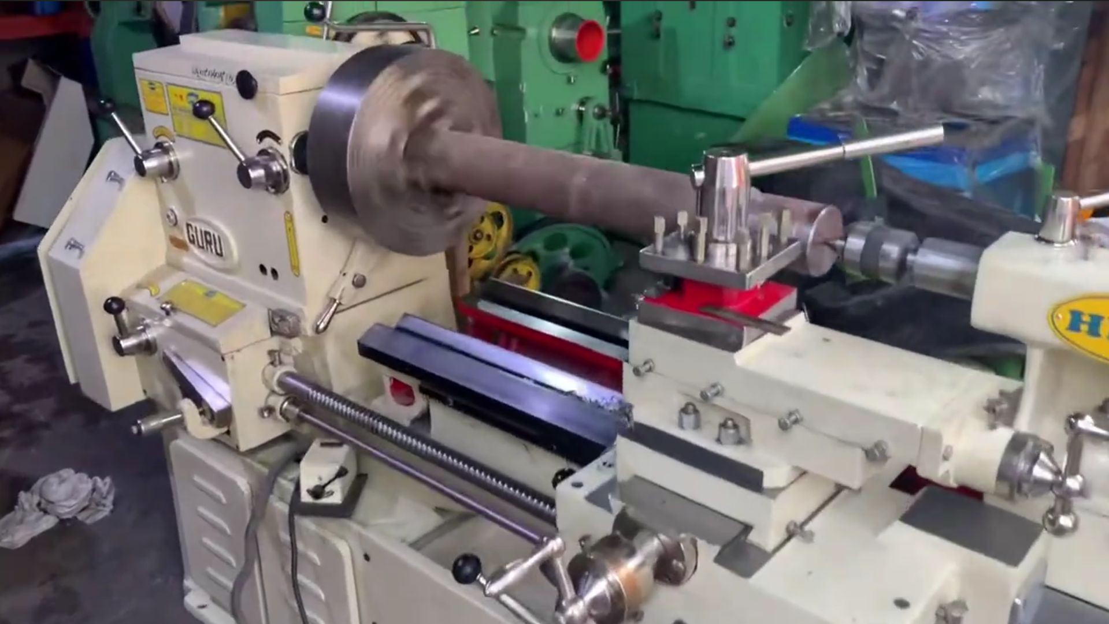
Die Manufacturing Plants: Process & Challenges
Existing flow (the way it appears)
  CNC, VMC, WIRECUT, EDM,
CUTTING LATHE,
MACHINE, CONVENTIONAL
CUTTING MACHINE
Challenges
CNC Machines
Variation in efficiency, number manufactured subjective to workers
of SKUs
Wire cutting Machine
Traceability of the components across different equipment in plant
Lathe Machine

Slide 7
Business Challenges
The Hidden Costs of Conventional Siloed PLC Management :-
01
Manual monitoring fails to capture and optimize the raw, intermediate and final products at plant.
02
Delayed Detection of mill
03
Manual/Notebook based
& equipment operation resulting in sub-standard final product.
reporting limited-no visibility. Delayed actions, production - economic loss.
04
Subjective operation of
1
05
Multiple silos in every plant equipment’s data are not interconnected. No
every PLC on PLC/equipment information coordinated
not between
centralised quantification and efficiency enhancement.
equipment/operator/super visor and managers.

Slide 8
Business Process Re-engineering
Know Our Application: ADAPT
What it is: ADAPT is a on premise system designed to provide real-time monitoring. It integrates with your existing PLCs and converts it into an Artificial Intelligence IoT Device
The Promise: Move from reactive firefighting to proactive, data-driven decision-making.
This Application empowers industries to significantly reduce wait-time, increase operational efficiency, and gain unparalleled insights

Slide 9
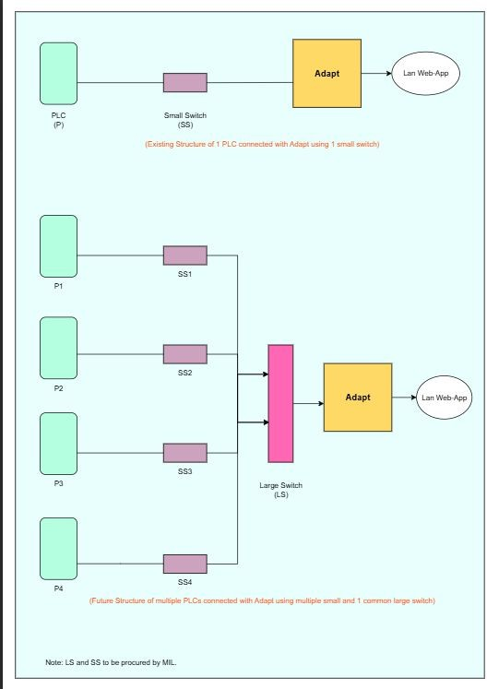
Schematic diagram for the system
Schematic Diagram of Connecting existing PLCs to our system, similar approach is used for interfacing with existing Devices
tı

Slide 10
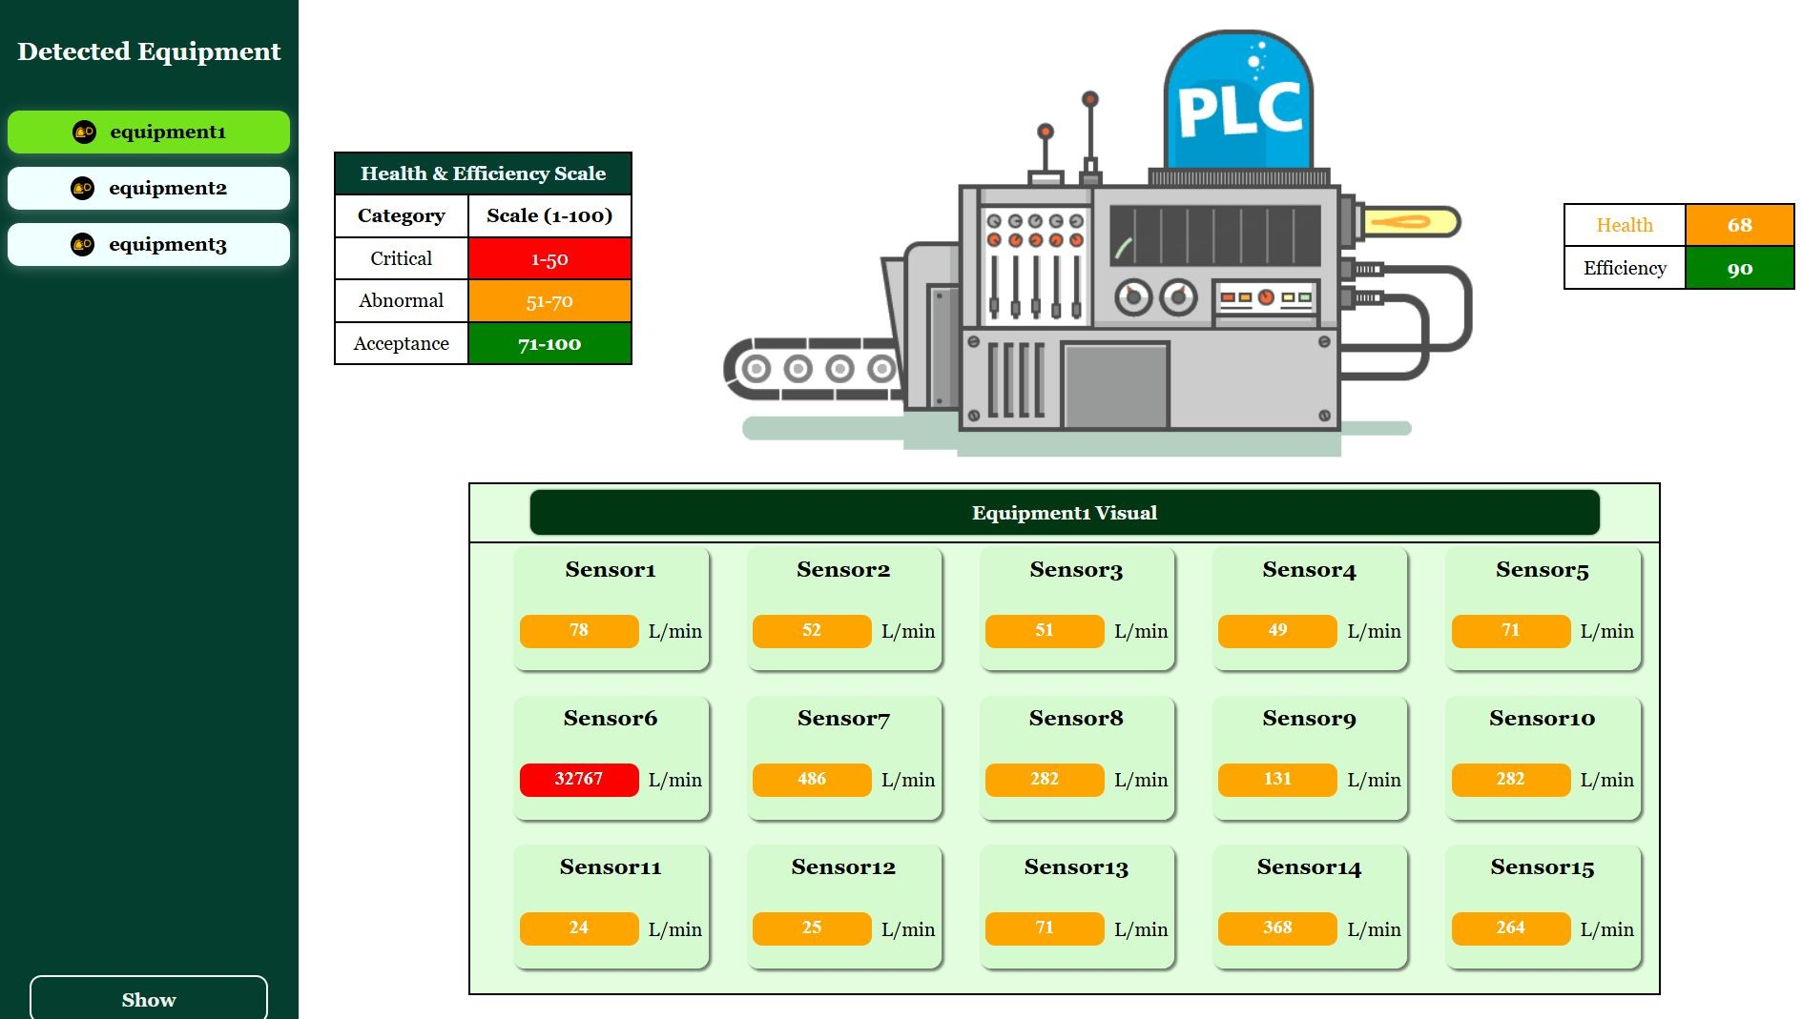
Steel - Aluminium Mill Data Streaming
Window for selecting specific equipment and the parameter streaming

Slide 11
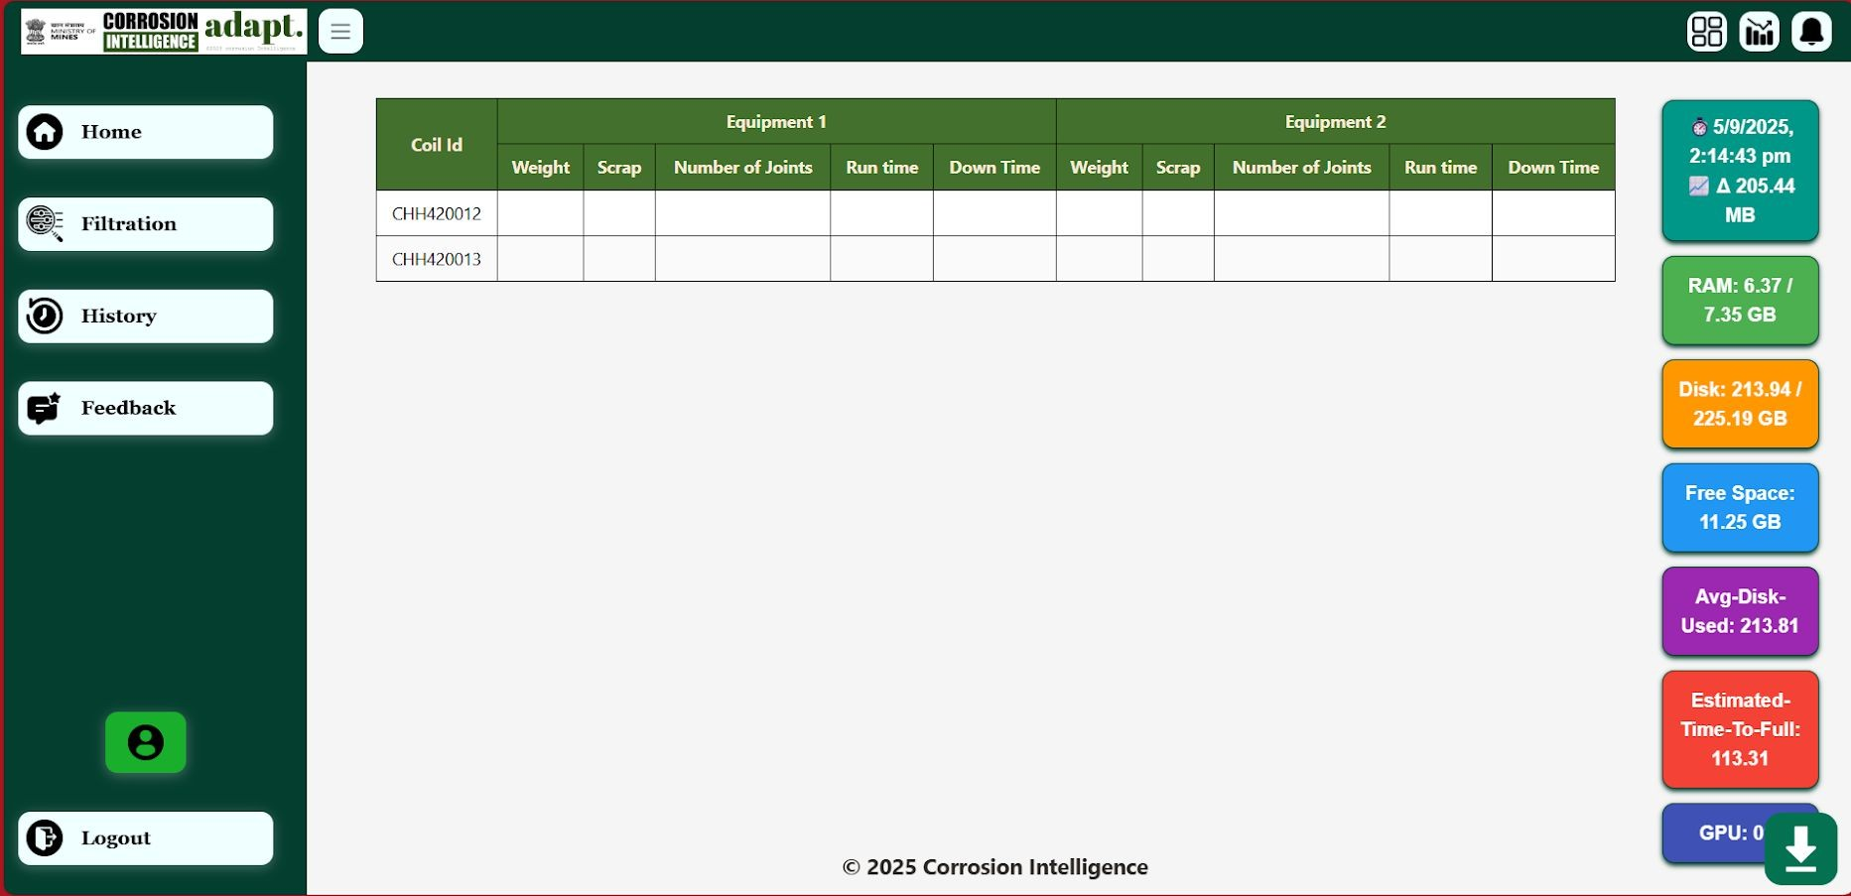
Steel - Aluminium Mill : Material Traceability Window
As per the material ID the traceability across different equipment

Slide 12
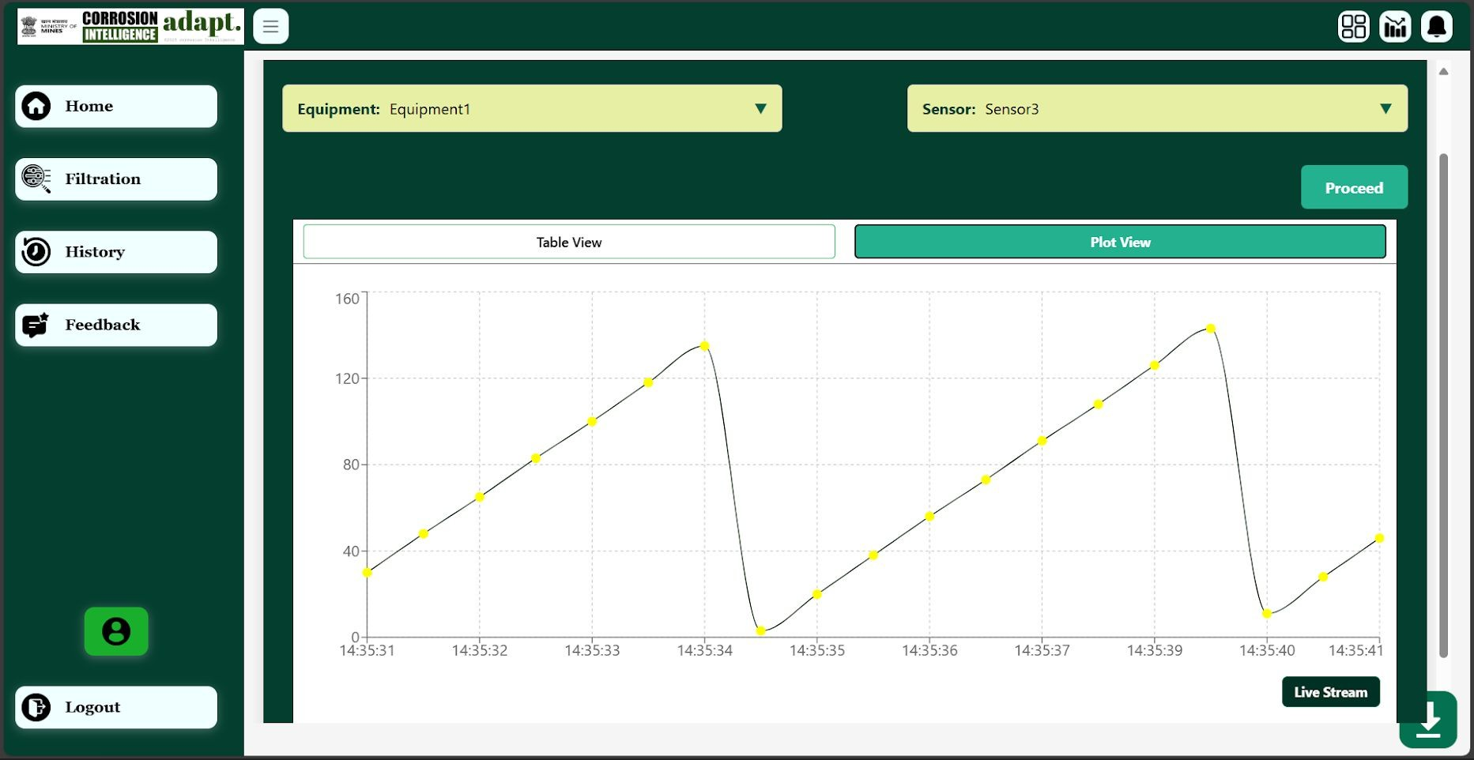
Steel - Aluminium Mill: Live Stream and Statistical Analysis
Live stream of data, Selection of period of interest and Statistical Analysis for insights

Slide 13
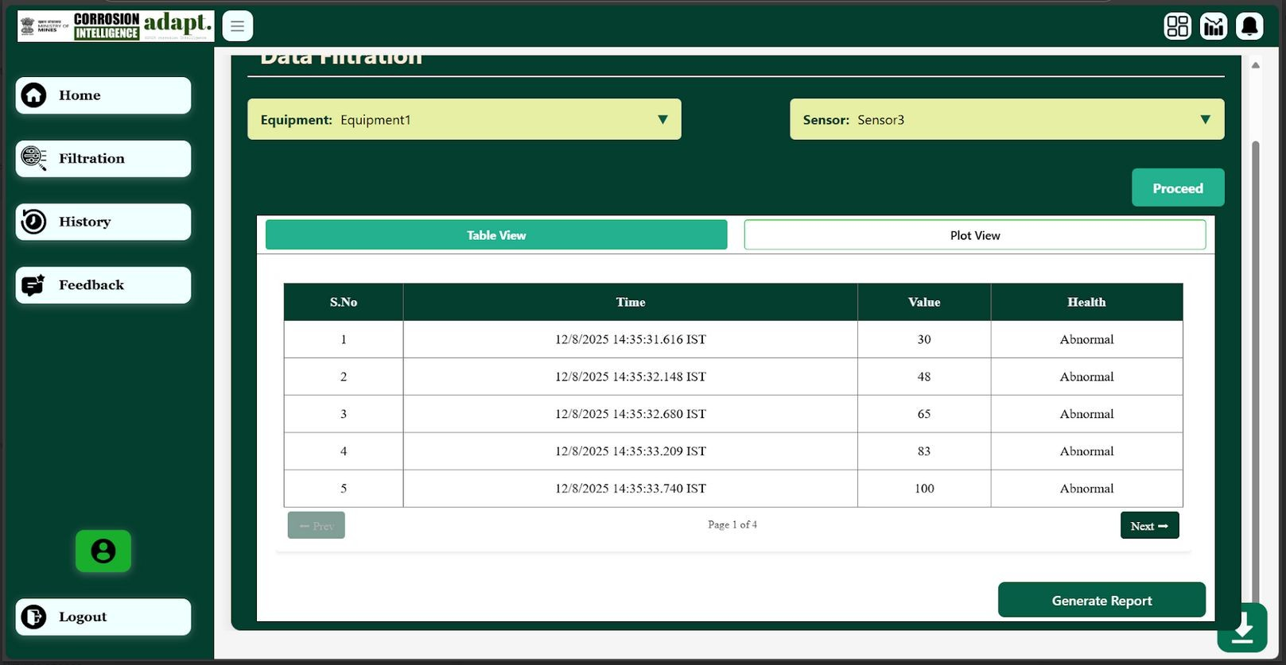
Steel - Aluminium Mill: Analysis and Filtration Window
Filtering of data and the Report Generation

Slide 14
About Caliche
About us
  A deep-tech startup registered in Meghalaya
  Vision: “To Build A General Intelligence Technology for Critical Assets”
  Mission: “To Deploy Corrosion Visibility Software Across Oil Storage and Refining Facilities”
Key Achievements
  Deployment at Kochi refinery Bharat Petroleum Corporation Limited
    increasing the Distillation Column Efficiency
  Work Order by Indian Oil Corporation for Maintenance and Inspection in tank farms
    Increased storage capacity of the storage tanks
  Work order by Marudhar Aluminium (Marudhar Industries Limited)
    Real-time integration of data across all equipment
    Increased equipment and plant efficiency
Business & Impact
  Recognized with NASSCOM National Award (Energy & Utilities - 2024), FIPI, MoPNG, KPMG

Slide 15




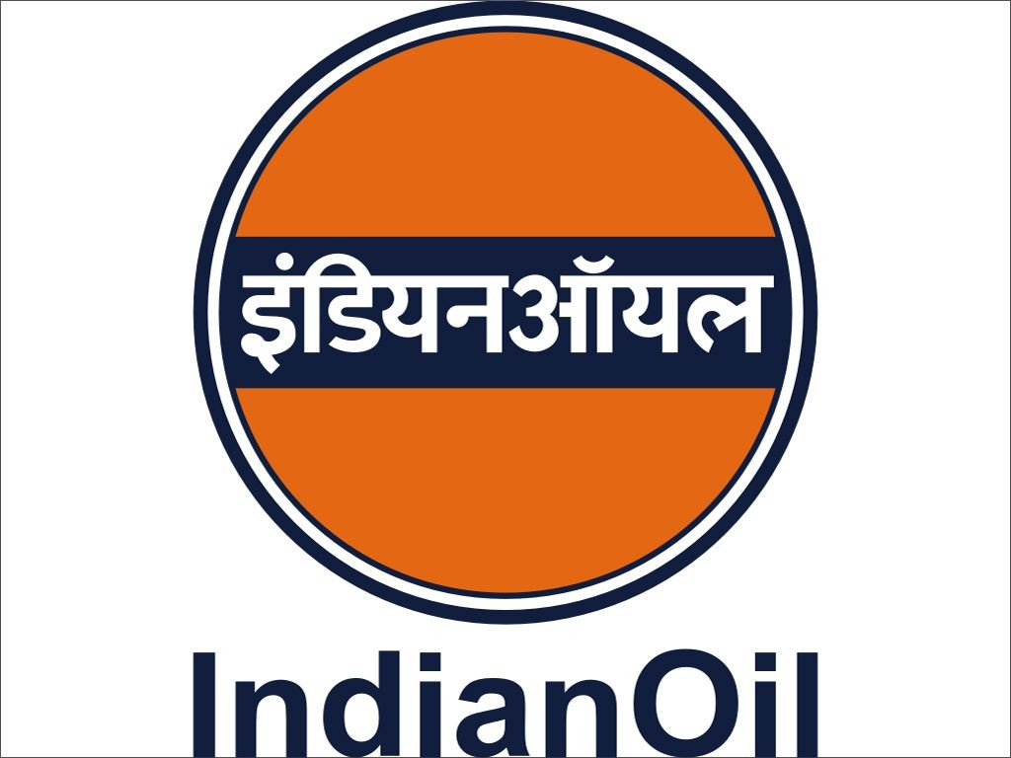
Some of the ongoing developments
S. No.
Organisation
Use case
1.
Bharat Petroleum Corporation Limited
Real-Time Visibility and Forecast in Crude Distillation Infrastructure
2.
Abu Dhabi National Oil Company
Real time visibility of corrosion progression in Condensate & Crude Oil Storage Infrastructure
3.
Marudhar Aluminium
Real time visibility of equipment health in Aluminium rolling infrastructure
4.
Jawaharlal Nehru Aluminium Research Development and Design Centre
Artificial Intelligence System for modelling and visibility of Aluminium Plants' Infrastructure
5.
Indian Oil Corporation Limited
Artificial Intelligence System for Storage tanks monitoring and maintenance scheduling
*Caliche has also served Oil India Limited, Oil and Natural Gas Corporation, Tata Steel & Mining Limited etc.

Slide 16
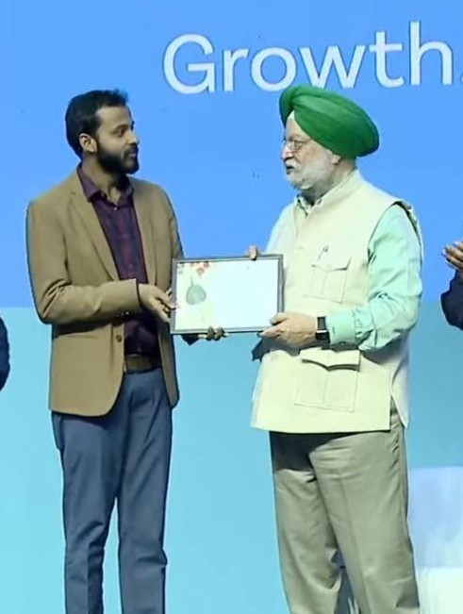
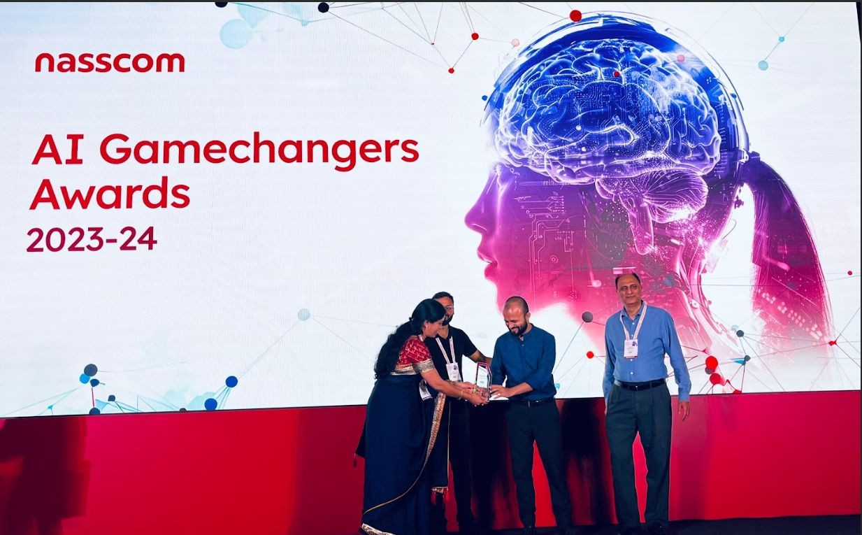
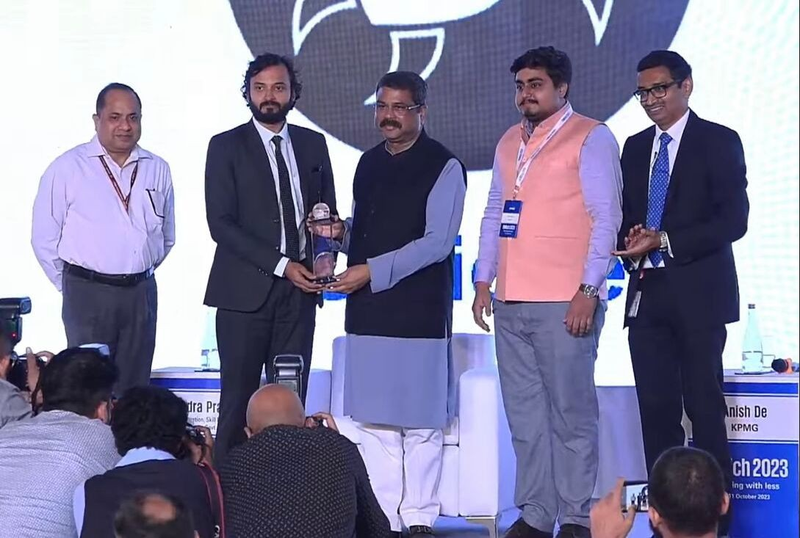
Awards and Recognitions
Winner of the “Best Startup Award” at the India Energy Week IEW
by Ministry of Petroleum & Natural Gas, Govt. of India.
Winner of the Best Startup under revenue generating category at KPMG ENRich 2023
Winner of Indian Achievers Award 2021 under “Promising Startup” Category
Featured in “Top 10 Oil & Gas Startups” globally for 3 consecutive years.
Ranked Top 5 globally in sustainability future play challenge.

Slide 17

Thank you.
Further feedback, clarification & enquiries can be directed to:
Ashutosh Kumar
+91 7903620014
ashutoshkumar@calicheglobal.com
Anandh Mathew
+91 88485 06410
anandhmathew@calicheglobal.com

